Slide 1

Supply Chain Traceability

Slide 2
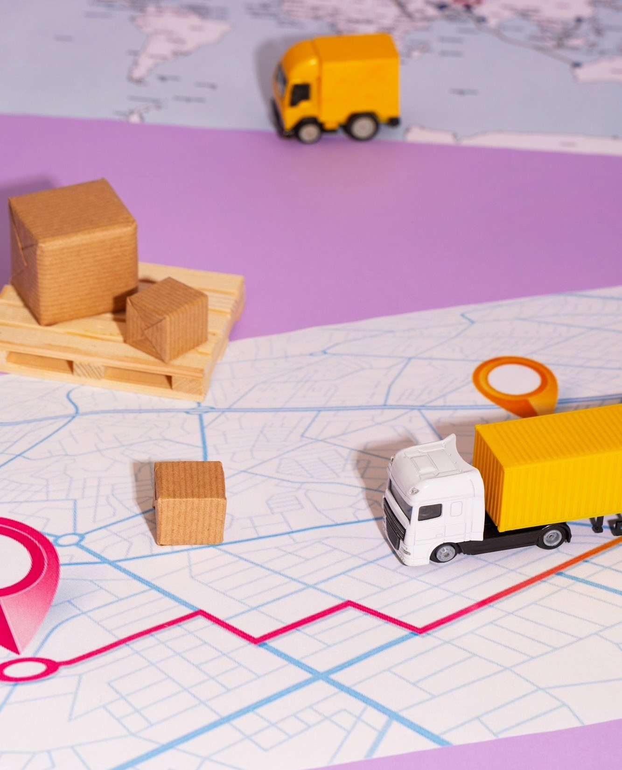
Introduction
Supply chain traceability is becoming increasingly important to ensure transparency and accountability in today's global market. With consumers demanding more information about the products they purchase, it's essential for companies to have a clear understanding of their supply chain.

Slide 3

What is Supply Chain Traceability?
Supply chain traceability is the ability to track a product from its origin to its ﬁnal destination.
This includes tracking the movement of raw
materials, components, and ﬁnished goods. It allows companies to identify potential issues and risks in their supply chain, and take action to address them.

Slide 4

Why is Traceability Important?
Traceability is important for several reasons. First, it helps ensure product safety by allowing companies to quickly identify and address any issues that arise. Second, it helps companies reduce risk by identifying potential issues before they become major problems. Finally, it helps companies build trust with consumers by providing them with information about the products they purchase.

Slide 5

Challenges of Supply Chain Traceability
While supply chain traceability is important, it can also be challenging to implement. One of the biggest challenges is lack of standardization in the industry.
This can make it difﬁcult for companies to share information and track products across multiple
supply chains. Additionally, implementing traceability can be costly and time-consuming.

Slide 6

Best Practices for Supply Chain Traceability
Despite the challenges, there are several best practices that companies can follow to implement effective supply chain traceability. These include establishing clear standards, collaborating with suppliers and partners, and leveraging technology such as blockchain and RFID to track products more efﬁciently.

Slide 7
Conclusion
In today's global market, supply chain traceability is essential to ensure transparency and accountability. While there are challenges to implementing traceability, companies can follow best practices to overcome them and build trust with consumers. By doing so, they can improve product safety, reduce risk, and ultimately, drive business success.

Slide 8
Thanks!
Name – Sumit Dutta
Enrollment No. – 22021002016006
Class roll – 58
Stream – CSE(AIML)

